Slide 1

Chapter 1
Software and Software Engineering
Introduction

Slide 2
Nature of Software – Defining Software
Software is:
Instructions (computer programs) that when executed provide desired features, function, and performance;
Data structures that enable the programs to adequately manipulate information.
Documentation that describes the operation and use of the programs.

Slide 3
What is Software?软件和硬件的区别
Software is developed or engineered it is not manufactured in the classical sense.不是工厂
Software doesn't "wear out“ but it does deteriorate.生命周期、变坏
Although the industry is moving toward component-based construction, most software continues to be custom-built.定制化

Slide 4
Software Application Domains
System software.
Application software.
Engineering/Scientific software.
Embedded software.
Product-line software.
Web/Mobile applications.
AI software (robotics, neural nets, game playing).

Slide 5
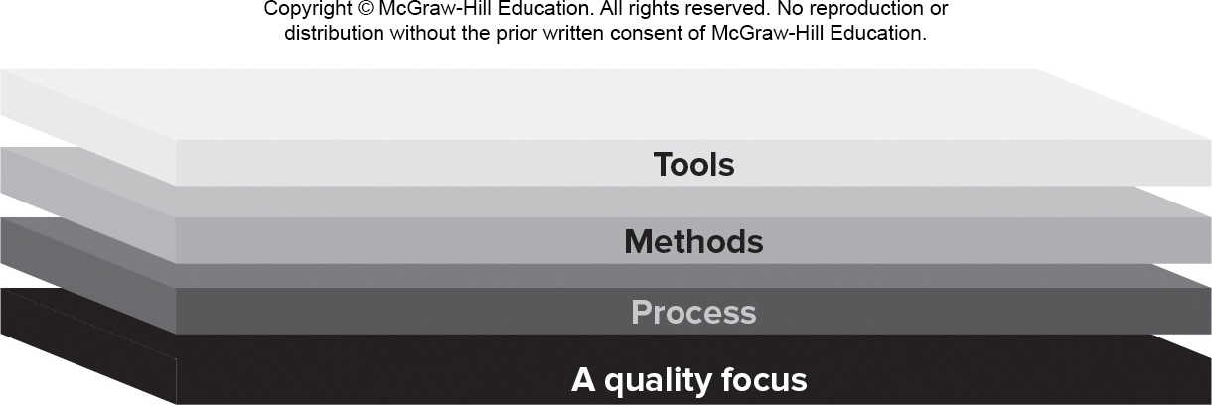
Software Engineering Layers

Slide 6
Process Framework Activities 5个阶段
Communication – Understand the problem.
Planning – Tasks, Dependencies, Schedule, Resources
Modeling.
Analysis of requirements.
Design.
Construction:
Code generation.
Testing.
Deployment.打包部署

Slide 7
Umbrella Activities 每一个阶段都要做的事 略讲
Umbrella activities help a software team manage and control the process, quality, change and risk.
Software project tracking and control. 项目跟踪
Risk management.风险控制
Software quality assurance.质量保证
Technical reviews. 技术审核
Measurement – KPIs (Key Performance Indicators).
Software configuration management. 版本控制
Reusability management.模块化
Work product preparation and production.部署

Slide 8
Essence核心关键of Software Engineering Practice
Polya suggests:
Understand the problem (communication and analysis).
Plan a solution (modeling and software design).
Carry out the plan (code generation).
Examine result for accuracy (testing & quality assurance).

Slide 9
Hooker’s General Principles
The Reason It All Exists – provide value to users.
K I S S (Keep It Simple, Stupid!) – design simple as it can be.
Maintain the Vision – clear vision is essential.
What You Produce, Others Will Consume.
Be Open to the Future - do not design yourself into a corner.
Plan Ahead for Reuse – reduces cost and increases value.
Think! – placing thought before action produce results.

Slide 10
Chapter 2
Process Models
Part 1 - The Software Process

Slide 11
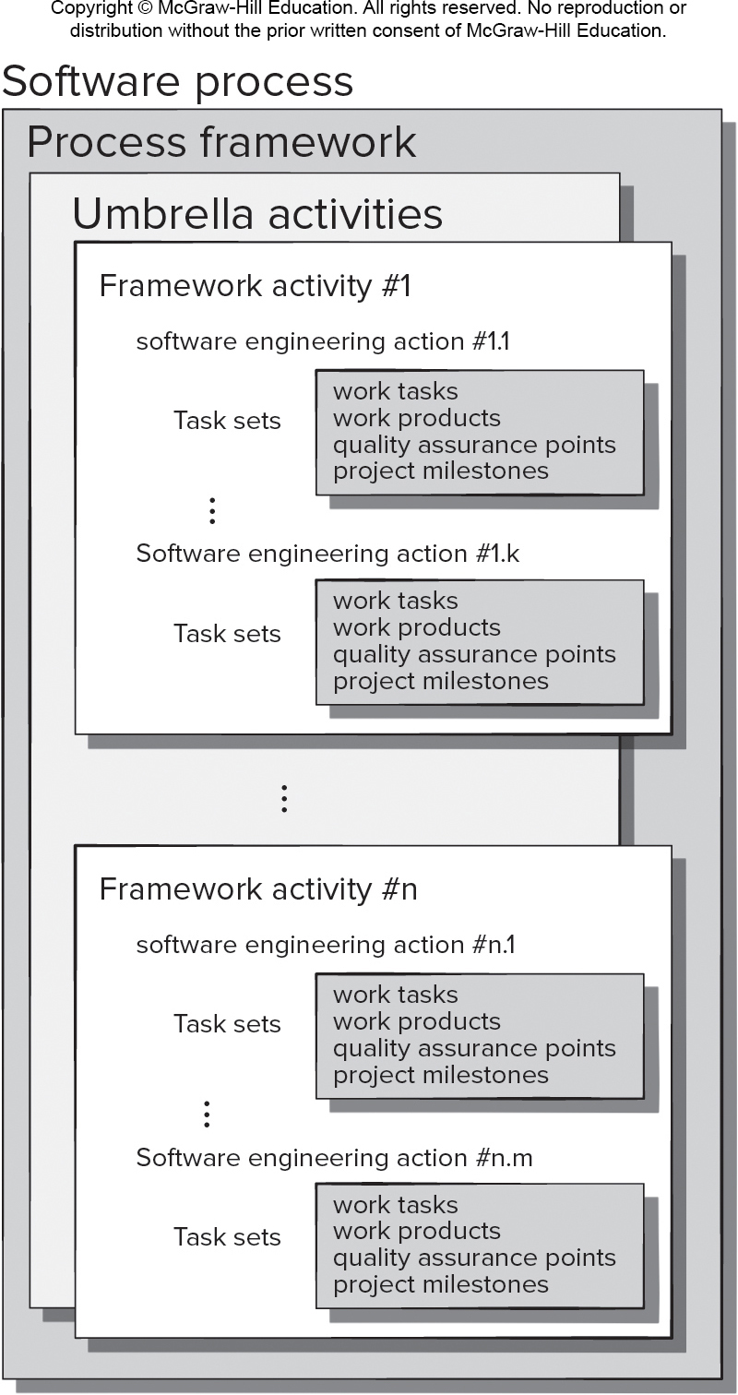
Generic Process Model
Access the text alternative for slide images.

Slide 12
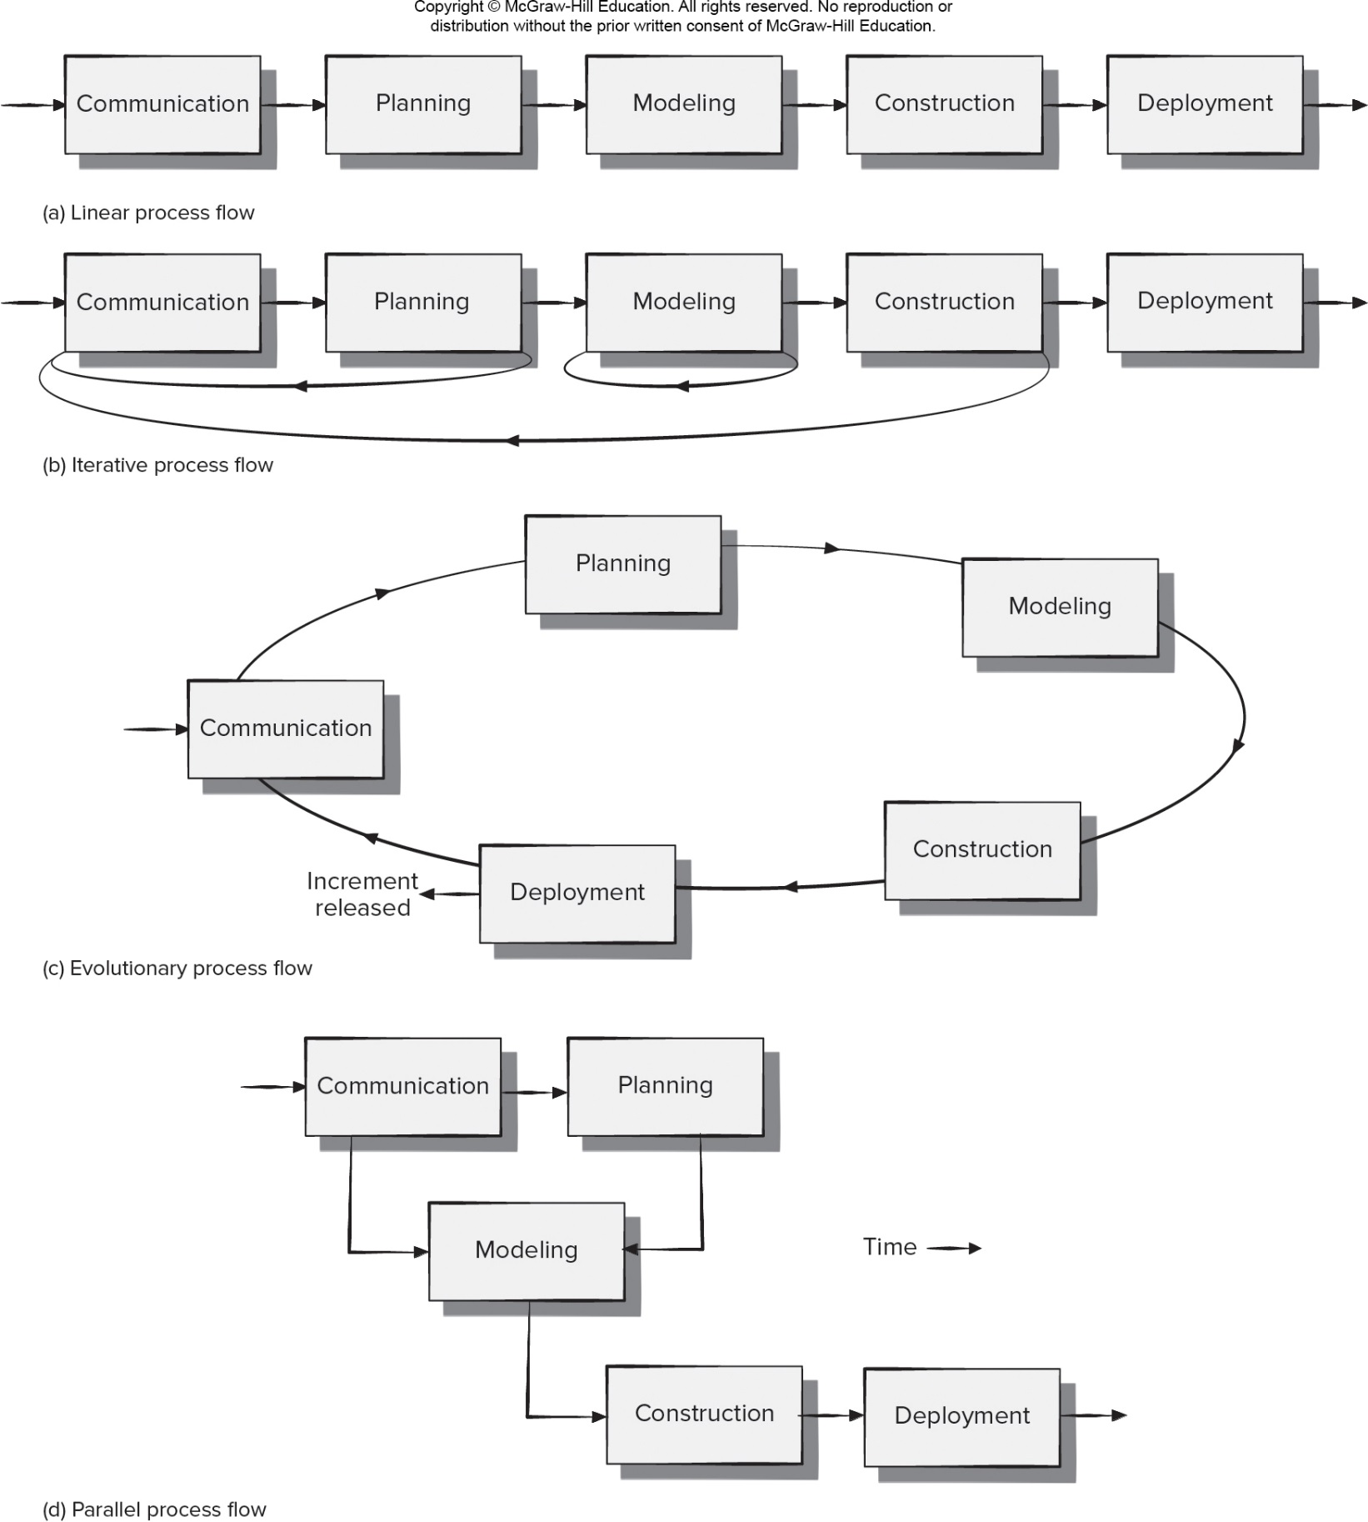
- Process Flow
Access the text alternative for slide images.

Slide 13
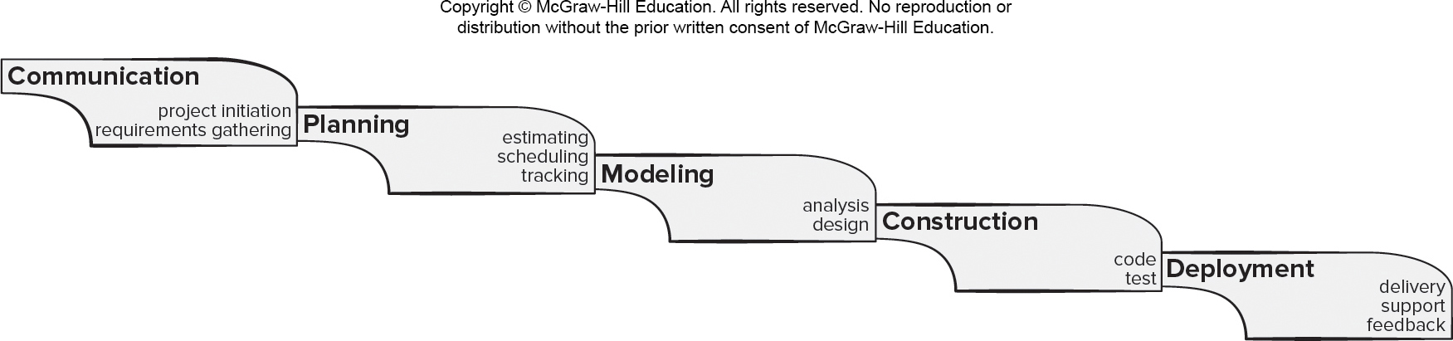
Waterfall Process Model 瀑布 不适合现在的软件开发
Pros
It is easy to understand and plan.
It works for well-understood small projects.
Analysis and testing are straightforward.
Cons
It does not accommodate change well.不灵活
Testing occurs late in the process.
Customer approval is at the end.
Access the text alternative for slide images.

Slide 14
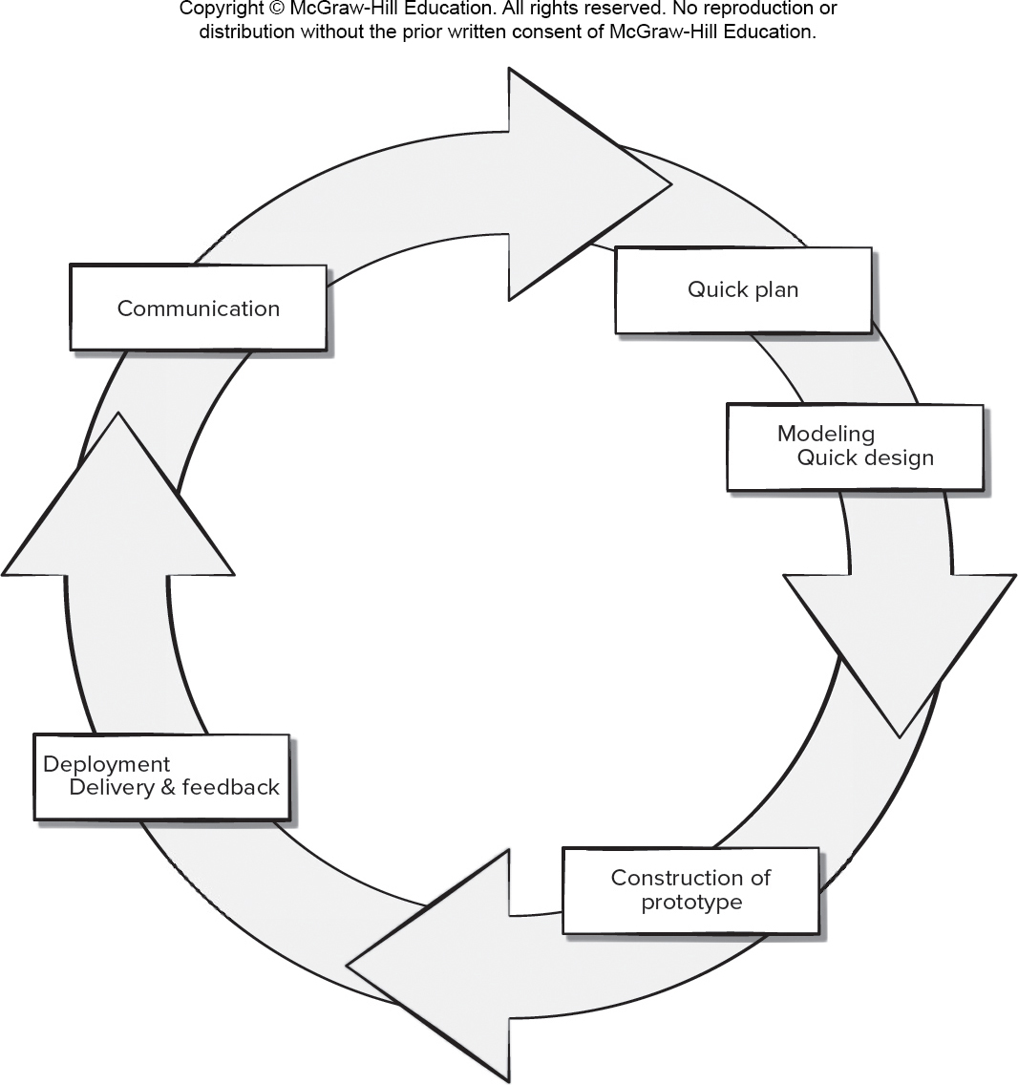
Prototyping Process Model 原型 快速
Pros
Reduced impact of requirement changes.
Customer is involved early and often.
Works well for small projects.
Reduced likelihood of product rejection.
Cons
Customer involvement may cause delays.
Temptation to “ship” a prototype.
Work lost in a throwaway prototype.
Hard to plan and manage.
Access the text alternative for slide images.

Slide 15
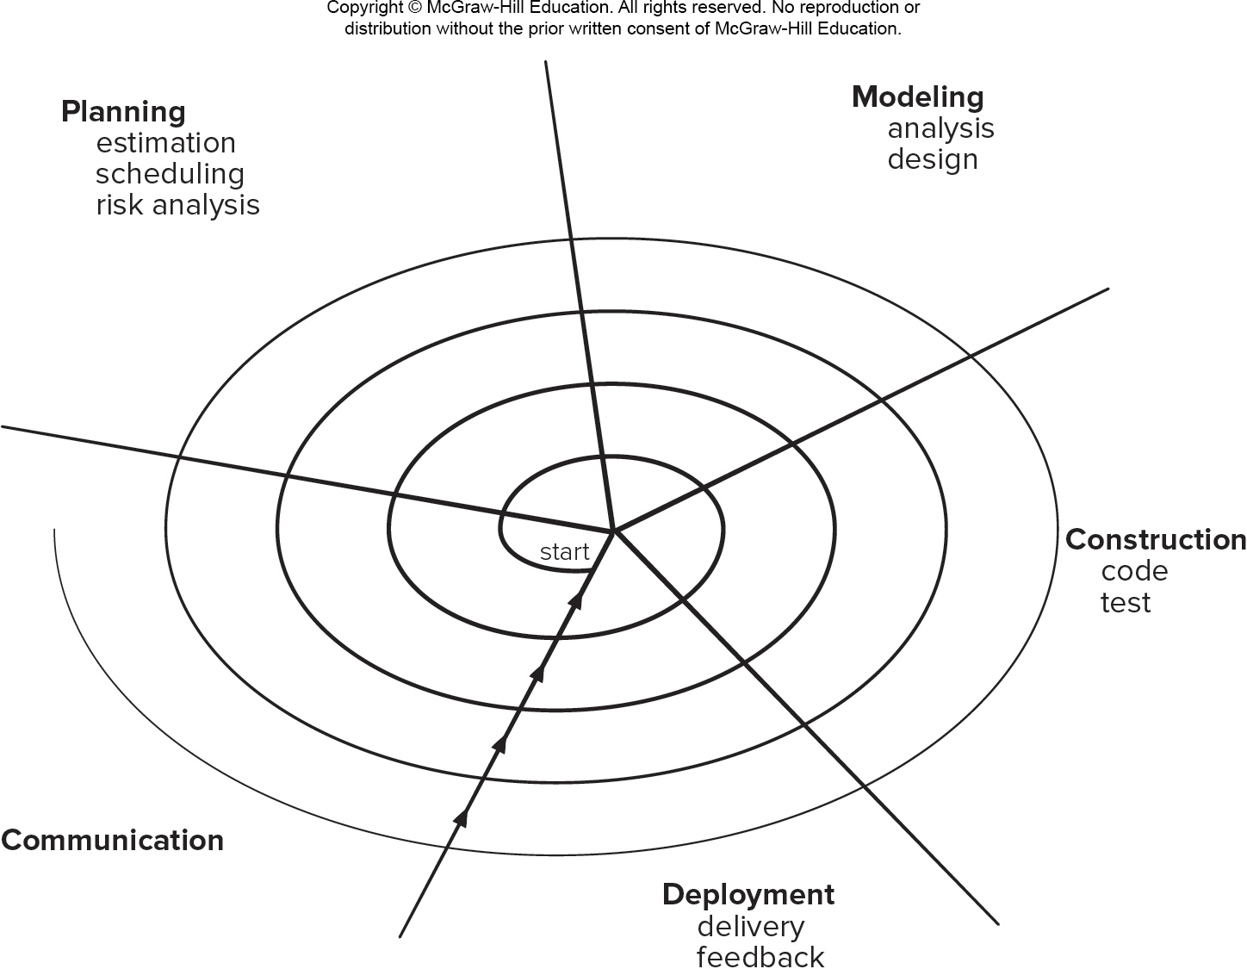
Spiral Process Model 循环 叠加
Pros
Continuous customer involvement.
Development risks are managed.
Suitable for large, complex projects.
It works well for extensible products.
Cons
Risk analysis failures can doom the project.
Project may be hard to manage.
Requires an expert development team.
Access the text alternative for slide images.

Slide 16
Chapter 3
Agility and Process
Part 1 - The Software Process

Slide 17
- What is Agility? 略讲
Effective (rapid and adaptive) response to change.
Effective communication among all stakeholders.
Drawing the customer onto the team.
Organizing a team so that it is in control of the work performed.
Rapid, incremental delivery of software.

Slide 18
- What is an Agile Process?
Driven by customer descriptions of what is required (scenarios).
Customer feedback is frequent and acted on.
Recognizes that plans are short-lived.
Develops software iteratively with a heavy emphasis on construction activities.
Delivers multiple ‘software increments’ as executable prototypes.
Adapts as project or technical changes occur.

Slide 19
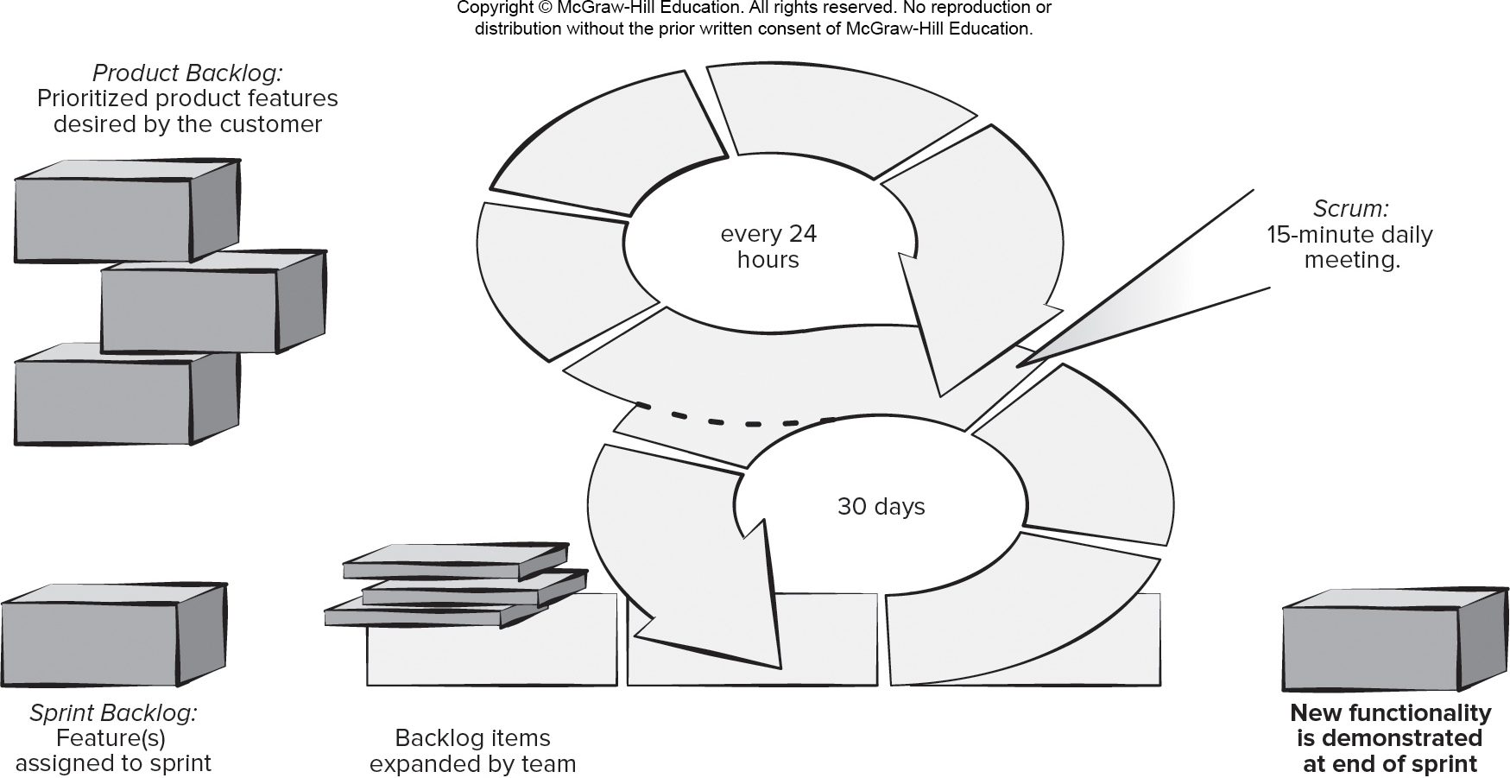
- Scrum Framework 敏捷开发的具体做法
Access the text alternative for slide images.

Slide 20
- Scrum Details
Backlog Refinement Meeting Developers work with stakeholders to create product backlog.
Sprint Planning Meeting Backlog partitioned into “sprints” derived from backlog and next sprint defined.
Daily Scrum Meeting Team members synchronize their activities and plan work day (15 minutes max).
Sprint Review Prototype “demos” are delivered to the stakeholders for approval or rejection.
Sprint Retrospective After sprint is complete, team considers what went well and what needs improvement.
Pros
Product owner sets priorities.
Team owns decision making.
Documentation is lightweight.
Supports frequent updating.
Cons
Difficult to control the cost of changes.
May not be suitable for large teams.
Requires expert team members.

Slide 21
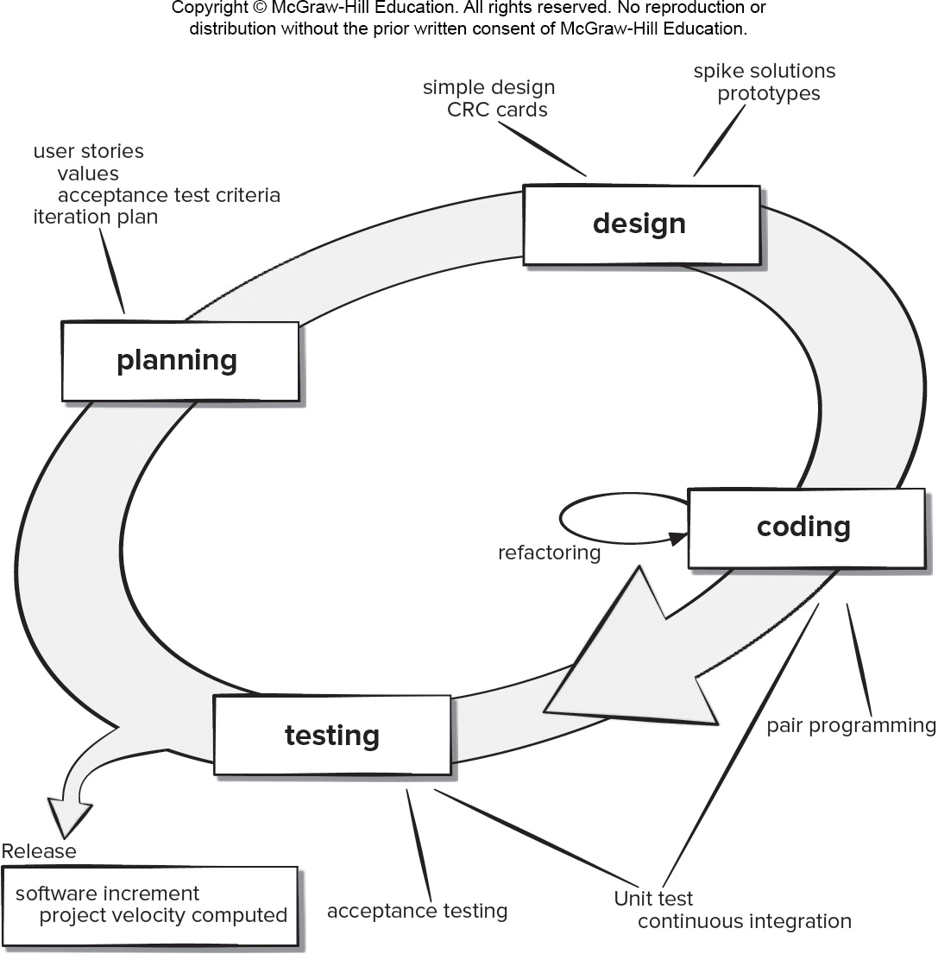
Extreme Programming (XP) Framework 极度编程
Access the text alternative for slide images.

Slide 22
Chapter 4
Recommended Process Model
Part One - The Software Process

Slide 23
Characteristics of Agile Process Models
Not suitable for large high-risk or mission critical projects.
Minimal rules and minimal documentation.
Continuous involvement of testers.
Easy to accommodate product changes.
Depends heavily on stakeholder interaction.
Easy to manage.
Early delivery of partial solutions.
Informal risk management.
Built-in continuous process improvement.

Slide 24
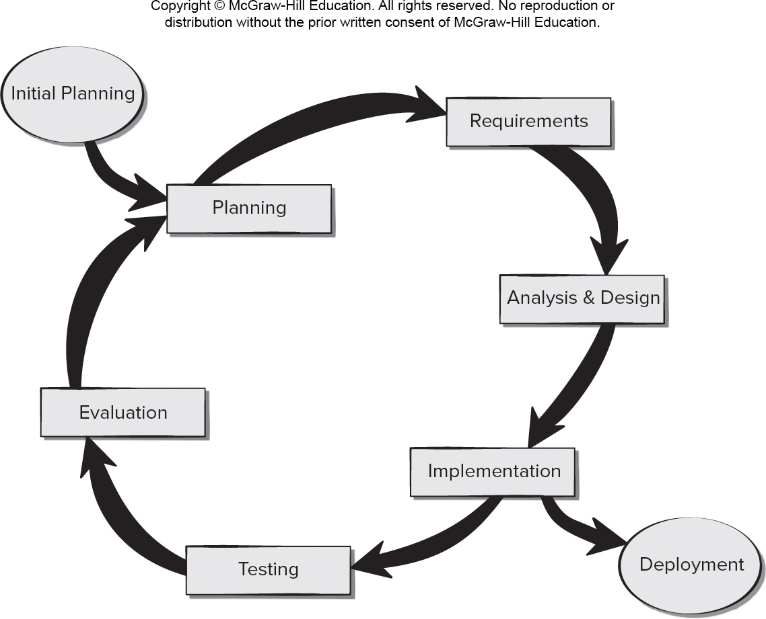
Incremental Model for Prototype Design 原型迭代
Access the text alternative for slide images.

Slide 25
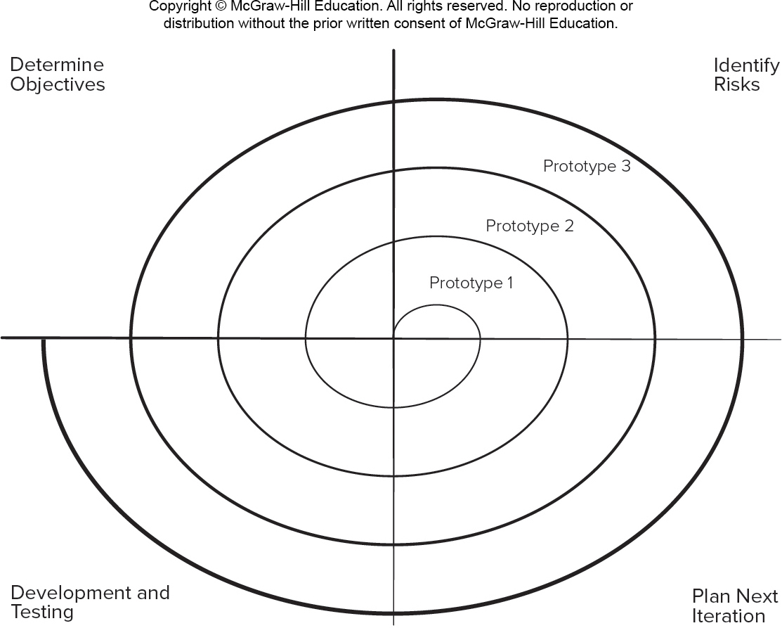
Spiral Model for Prototype Design 原型 循环的叠加
Access the text alternative for slide images.

Slide 26
- First Prototype Guidelines 指导原则 没必要按这个做
Transition from paper prototype to software design.
Prototype a user interface.
Create a virtual prototype.
Add input and output to your prototype.
Engineer your algorithms.
Test your prototype.
Prototype with deployment in mind.
Resource人力

Slide 27
- Prototype Evaluation
Provide scaffolding when asking for prototype feedback.
Test your prototype on the right people.
Ask the right questions.
Be neutral when presenting alternatives to users.
Adapt while testing.
Allow the user to contribute ideas.

Slide 28
- Go No Go Decision

Slide 29
Software Release Maintenance
Maintenance - activities needed to keep software operational after it has been accepted and released in the end-user environment.
Corrective maintenance - reactive modification of software to repair problems discovered after the software has been delivered.
Adaptive maintenance - reactive modification of software after delivery to keep the software usable in a changing environment.
Perfective maintenance - proactive modification of the software after delivery to provide new user features, better program code structure, or improved documentation.
Preventive maintenance – proactive modification software after delivery to correct product faults before discovery by users.
In agile process models much (but not all) of the maintenance work is preventive or perfective as new features are added.

Slide 30
Chapter 5
Human Aspects of Software Engineering
Part One - The Software Process

Slide 31
Traits of Successful Software Engineers
Sense of individual responsibility.
Acutely aware of the needs of team members and stakeholders（用户、公司决策者）.
Brutally honest about design flaws and offers constructive criticism.
Resilient under pressure.
Heightened sense of fairness.
Attention to detail.
Pragmatic adapting software engineering practices based on the circumstances at hand.

Slide 32
Effective Software Team Attributes
Sense of purpose.使命感
Sense of involvement.参与感
Sense of trust.
Sense of improvement.
Diversity of team member skill sets.多样化
Global Software

Slide 33
Chapter 6
Principles that Guide Practice
Part Two - Modeling

Slide 34
Principles that Guide Process 1
Principle #1. Be agile. Regards of your process model, let the basic tenets of agile development govern your approach.
Principle #2. Focus on quality at every step. The exit condition for every process activity, action, and task should focus on the quality of the work product produced.
Principle #3. Be ready to adapt. Dogma has no place in software development. Adapt your approach to constraints imposed by the problem, the people, and the project itself.
Principle #4. Build an effective team. Software engineering process and practice are important, but the bottom line is people. Build a self-organizing team.

Slide 35
Principles that Guide Process 2
Principle #5. Establish mechanisms for communication and coordination. Projects fail because information falls into the cracks and/or stakeholders fail to coordinate their efforts.
Principle #6. Manage change. Approach may formal or informal. You need mechanisms to manage how changes are requested, assessed, approved and implemented.
Principle #7. Assess risk. Lots of things can go wrong as software is being developed, establish contingency plans.
Principle #8. Create work products that provide value for others. Create only those work products that provide value for other process activities, actions or tasks.

Slide 36
Principles that Guide Practice 1
Principle #1. Divide and conquer. Analysis and design should always emphasize separation of concerns (SoC).
Principle #2. Understand the use of abstraction. Abstraction is a simplification of a complex system element used to communication meaning simply.
Principle #3. Strive for consistency. A familiar context makes software easier to use.
Principle #4. Focus on the transfer of information. Pay special attention to the analysis, design, construction, and testing of interfaces.

Slide 37
Principles that Guide Practice 2
Principle #5. Build software that exhibits effective modularity. Provides a mechanism for realizing the philosophy of Separation of concerns .
Principle #6. Look for patterns. The goal of patterns is to create a body of literature to help developers resolve recurring problems encountered in software development.
Principle #7. Use multiple viewpoints. Represent the problem and solution from different perspectives.
Principle #8. Some consumes your work products. Remember that someone will maintain the software.

Slide 38
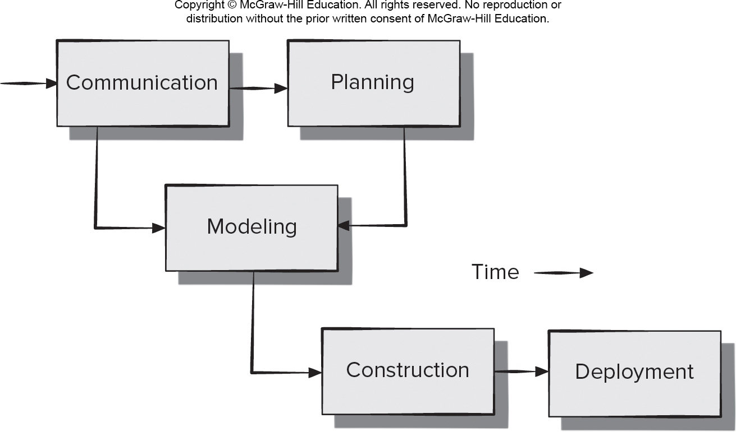
Simplified Process Framework
Access the text alternative for slide images.

Slide 39
Communications Principles 1
Principle #1. Listen. Try to focus on the speaker’s words, not formulating your response to those words.
Principle # 2. Prepare before you communicate. Understand a problem before meeting with others.
Principle # 3. Someone should facilitate the activity. Every communication meeting should have a leader to keep the conversation moving in a productive direction.
Principle #4. Face-to-face communication is best. Visual representations of information can be helpful.
Principle # 5. Take notes and document decisions. Someone should serve as a “recorder” and write down all important points and decisions.

Slide 40
Communications Principles 2
Principle # 6. Strive for collaboration. Consensus occurs when collective team knowledge is combined.
Principle # 7. Stay focused, modularize your discussion. The more people involved in communication the more likely discussion will bounce between topics.
Principle # 8. If something is unclear, draw a picture.
Principle # 9. (a) Once you agree to something, move on; (b) If you can’t agree to something, move on; (c) If a feature or function is unclear and cannot be clarified at the moment, move on.
Principle # 10. Negotiation is not a contest or a game. It works best when both parties win.

Slide 41
Planning Principles 1
Principle #1. Understand the scope of the project. Scope provides the software team with a destination as the roadmap is created.
Principle #2. Involve the customer in the planning activity. They define priorities and project constraints.
Principle #3. Recognize that planning is iterative. A project plan is likely to change as work begins.
Principle #4. Estimate based on what you know. Estimation provides an indication of effort, cost, and task duration, based on team’s current understanding of work.
Principle #5. Consider risk as you define the plan. Contingency planning is needed for identified high impact and high probability risks.

Slide 42
Planning Principles 2
Principle #7. Adjust granularity as you define the plan. Granularity refers to the level of detail that is introduced as a project plan is developed.
Principle #8. Define how you intend to ensure quality. Your plan should identify how the software team intends to ensure quality.
Principle #9. Describe how you intend to accommodate change. Even the best planning can be obviated by uncontrolled change.
Principle #10. Track the plan frequently and make adjustments as required. Software projects fall behind schedule one day at a time.

Slide 43
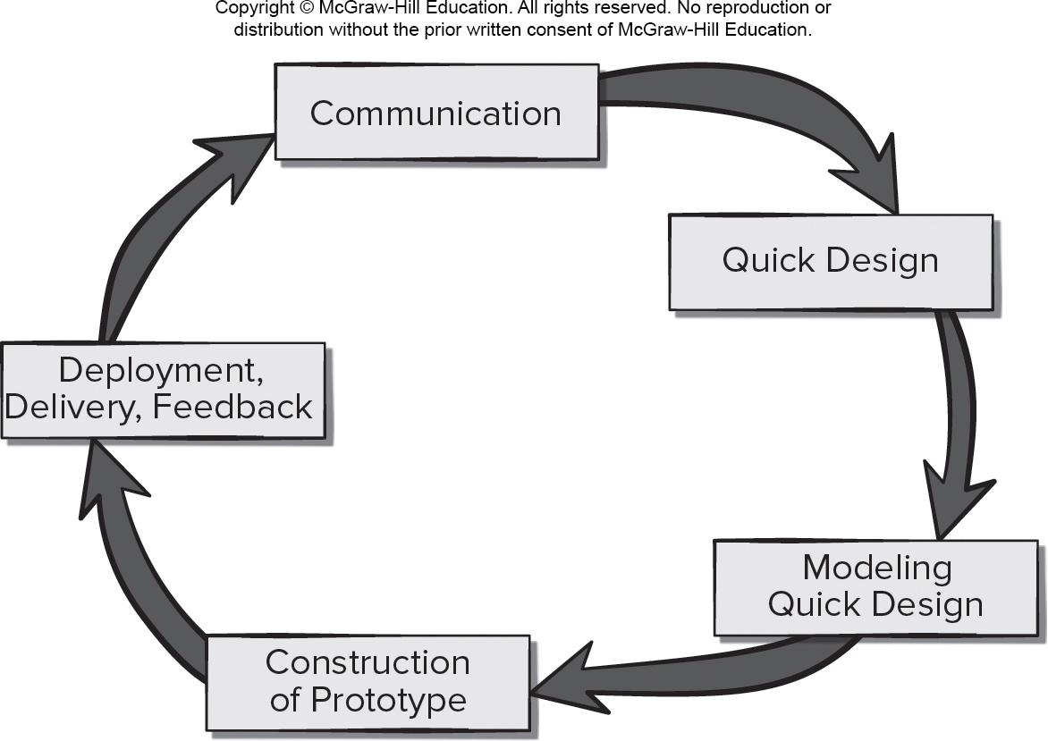
Software Modeling 敏捷的过程
Access the text alternative for slide images.

Slide 44
Agile Modeling Principles 1
Principle #1. The primary goal of the software team is to build software not create models.
Principle #2. Travel light – don’t create more models than you need.
Principle #3. Strive to produce the simplest model that will describe the problem or the software.
Principle #4. Build models in a way that makes them amenable to change.
Principle #5. Be able to state an explicit purpose for each model that is created.

Slide 45
Agile Modeling Principles 2
Principle #6. Adapt the models you create to the system at hand.
Principle #7. Try to build useful models, forget abut building perfect models.
Principle #8. Don’t become dogmatic about model syntax. Successful communication is key.
Principle #9. If your instincts tell you a paper model isn’t working you may have a reason to be concerned.
Principle #10. Get feedback as soon as you can.

Slide 46
Construction Principles - Coding 1
Preparation Principles: Before you write one line of code, be sure you:
Principle 1. Understand the problem to be solved.
Principle 2. Understand basic design principles and concepts.
Principle 3. Pick a programming language that meets the needs of the software to be built.
Principle 4. Select a programming environment that provides tools that will make your work easier.
Principle 5. Create a set of unit tests that will be applied once the component you code is completed.

Slide 47
Construction Principles - Coding 2
Coding Principles: As you begin writing code, be sure you:
Principle 6. Constrain your algorithms by following structured programming practice.
Principle 7. Consider the use of pair programming.
Principle 8. Select data structures that will meet the needs of the design.
Principle 9. Understand the software architecture and create interfaces that are consistent with it.

Slide 48
Construction Principles - Coding 3
Validation Principles: After you’ve completed your first coding pass, be sure you:
Principle 10. Conduct a code walkthrough when appropriate.
Principle 11. Perform unit tests and correct errors you’ve uncovered.
Principle 12. Refactor the code to improve its quality.

Slide 49
Chapter 7
Understanding Requirements
Part Two - Modeling

Slide 50
Requirements Engineering 1
Inception - establish a basic understanding of the problem, the people who want a solution, and the nature of the solution that is desired, important to establish effective customer and developer communication.
Elicitation - elicit requirements and business goals from all stakeholders.
Elaboration - focuses on developing a refined requirements model that identifies aspects of software function, behavior, and information.

Slide 51
Requirements Engineering 2
Negotiation—agree on the scope of a deliverable system that is realistic for developers and customers.
Specification—can be any or all of the following: written documents, graphical models, mathematical models, usage scenarios, prototypes.
Validation—Requirements engineering work products produced during requirements engineering are assessed for quality and consistency.
Requirements management – set of traceability activities to help the project team identify, control, and track requirements and their changes to requirements as the project proceeds.

Slide 52
Non-functional Requirements非功能需求
Non-Functional Requirement (N F R) – quality attribute, performance attribute, security attribute, or general system constraint.质量 性能 安全 系统局限性
A two-phase process is used to determine which N F R’s are compatible:
The first phase is to create a matrix using each N F R as a column heading and the system S E guidelines a row labels.
The second phase is for the team to prioritize each N F R using a set of decision rules to decide which to implement by classifying each N F R and guideline pair as complementary, overlapping, conflicting, or independent.

Slide 53
Analysis Model Elements
Analysis model provides a description of the required informational, functional, and behavioral domains for a computer-based system.
Scenario-based elements – functional descriptions are express in the customers own words and user stories and as interactions of actors with the system expressed using U M L use case diagrams.应用场景
Class-based elements – collections of attributes and behaviors implied by the user stories and expressed using U M L class diagrams (information domain).
Behavioral elements – may be expressed using U M L state diagrams as inputs causing state changes.
UML

Slide 54
Chapter 8
Requirements Modeling – A Recommended Approach
Part Two - Mobility.

Slide 55
Requirements Models
Scenario-based models depict requirements from the point of view of various system “actors.”
Class-oriented models represent object-oriented classes (attributes and operations) and how classes collaborate to achieve system requirements.
Behavioral models depict how the software reacts to internal or external “events.”
Data models depict the information domain for the problem.
Flow-oriented models represent functional elements of the system and how they transform data in the system.

Slide 56
Requirements Modeling Principles
Principle 1. The information domain of a problem must be represented and understood.
Principle 2. The functions that the software performs must be defined.
Principle 3. The behavior of the software (as a consequence of external events) must be represented.
Principle 4. The models that depict information, function, and behavior must be partitioned in a manner that uncovers detail in a layered (or hierarchical) fashion.
Principle 5. The analysis task should move from essential information toward implementation detail.

Slide 57
Use Cases
Use case as a “contract for behavior” and more formal than a user story.
Use-cases are simply an aid to defining what exists outside the system (actors) and what should be performed by the system (use-cases).
What should we write about?
How much should we write about it?
How detailed should we make our description?
How should we organize the description?

Slide 58
Chapter 9
Design Concepts
Part Two - Modeling

Slide 59
Software Engineering Design
Data/Class design – transforms analysis classes into implementation classes and data structures.
Architectural design – defines relationships among the major software structural elements.
Interface design – defines how software elements, hardware elements, and end-users communicate.
Component-level design – transforms structural elements into procedural descriptions of software components.

Slide 60
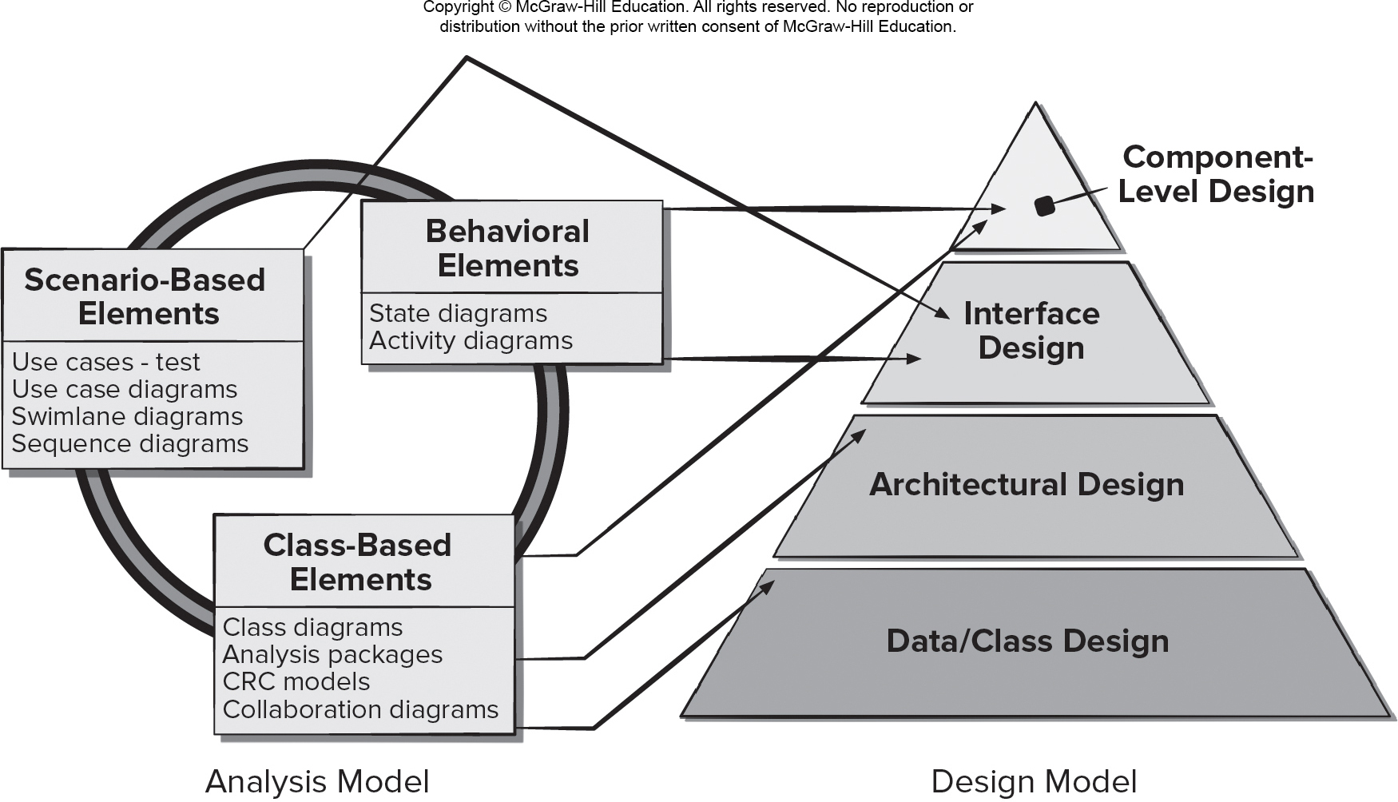
Mapping Requirements Model to Design Model
Access the text alternative for slide images.

Slide 61
Architecture Properties
Structural properties. This aspect of the architectural design representation defines the components of a system (for example, modules, objects, filters) and the manner in components are packaged and interact with one another.
Extra-functional properties. The architectural design description should address how the design architecture achieves requirements for performance, capacity, reliability, security, adaptability, and other characteristics.
Families of related systems. The architectural design should draw upon repeatable patterns (building blocks) often encountered in the design of similar systems.
Information Hiding

Slide 62
Chapter 10
Architectural Design – A Recommended Approach
Part Two - Modeling

Slide 63
What is Software Architecture?
The architecture is not the operational software, it is a representation that enables a software engineer to:
Analyze the effectiveness of the design in meeting its stated requirements,
Consider architectural alternatives at a stage when making design changes is still relatively easy, and
Reduce the risks associated with the construction of the software.

Slide 64
Architectural Styles
Each style describes a system category that encompasses:
set of components (for example: a database, computational modules) that perform a function required by a system.
set of connectors that enable “communication, coordination and cooperation” among components.
constraints that define how components can be integrated to form the system.
semantic models that enable a designer to understand the overall properties of a system by analyzing the known properties of its constituent parts.

Slide 65
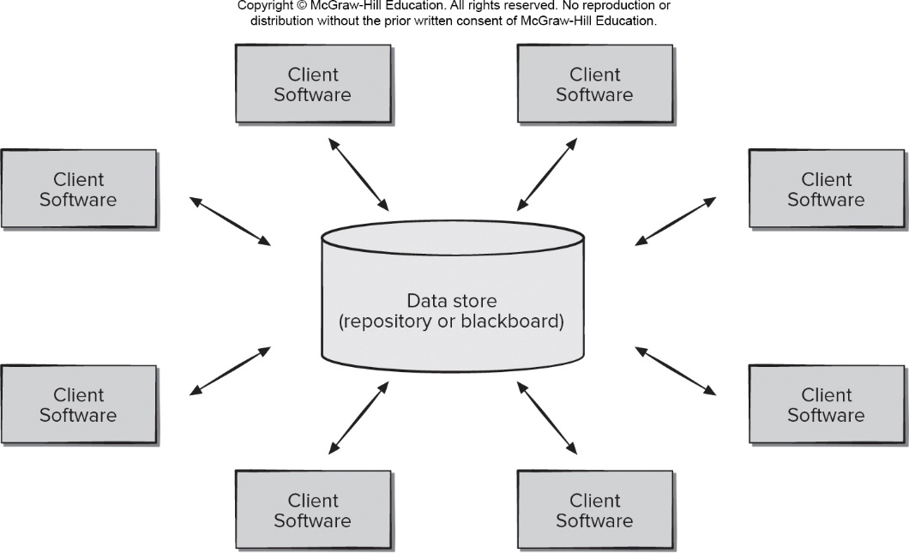
Data Centered Architecture
Access the text alternative for slide images.

Slide 66
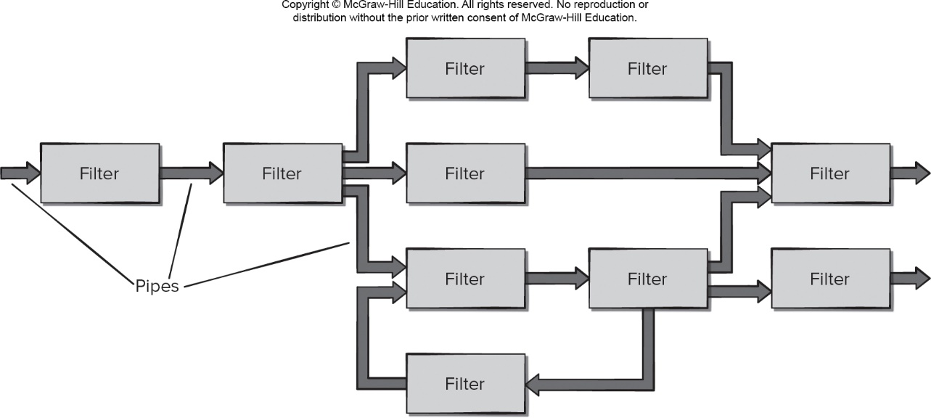
Data Flow Architecture
Access the text alternative for slide images.

Slide 67
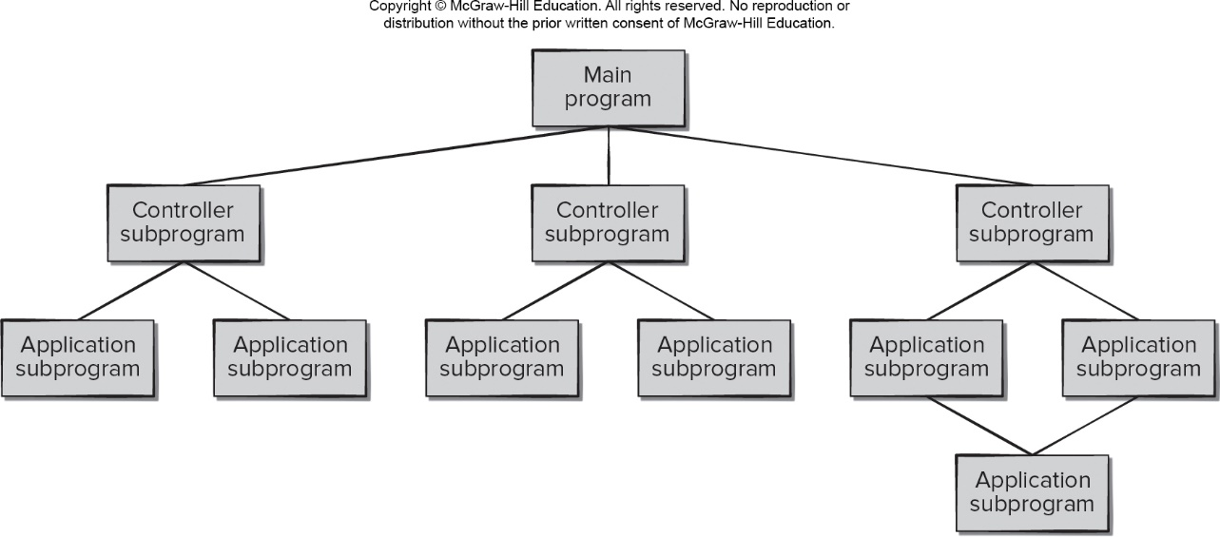
Call Return Architecture
Access the text alternative for slide images.

Slide 68
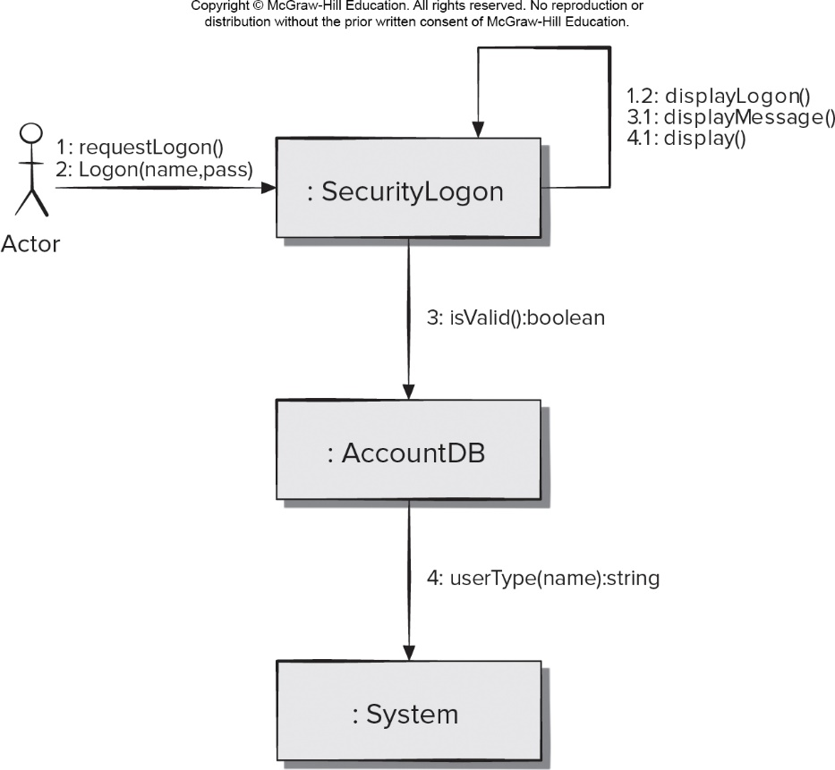
Object-Oriented Architecture
Access the text alternative for slide images.

Slide 69
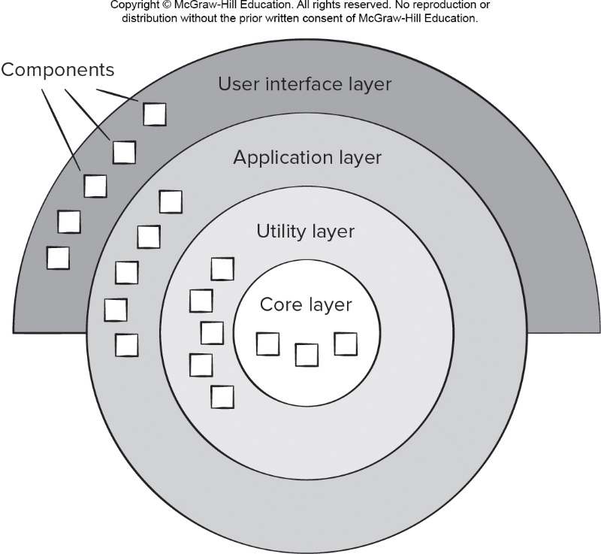
Layered Architecture
Access the text alternative for slide images.

Slide 70
Architectural Organization and Refinement 1
Control.
How is control managed within the architecture?
Does a distinct control hierarchy exist, and if so, what is the role of components within this control hierarchy?
How do components transfer control within the system?
How is control shared among components?
What is the control topology (that is, the geometric form that the control takes)?
Is control synchronized, or do components operate asynchronously?

Slide 71
Architectural Organization and Refinement 2
Data.
How are data communicated between components?
Is the flow of data continuous, or are data objects passed to the system sporadically?
What is the mode of data transfer?
Do data components exist, and if so, what is their role?
How do functional components interact with data components?
Are data components passive or active?
How do data and control interact within the system?

Slide 72
Architectural Considerations
Economy – software is uncluttered and relies on abstraction to reduce unnecessary detail.
Visibility – Architectural decisions and their justifications should be obvious to software engineers who review.
Spacing – Separation of concerns in a design without introducing hidden dependencies.
Symmetry – Architectural symmetry implies that a system is consistent and balanced in its attributes.
Emergence – Emergent, self-organized behavior and control are key to creating scalable, efficient, and economic software architectures.

Slide 73
Architectural Reviews
Assess the ability of the software architecture to meet the systems quality requirements and identify potential risks.
Have the potential to reduce project costs by detecting design problems early.
Often make use of experience-based reviews, prototype evaluation, and scenario reviews, and checklists.

Slide 74
Chapter 11
Component-Level Design
Part Two - Modeling

Slide 75
Component-Level Design Guidelines
Components - Naming conventions should be established for components that are specified as part of the architectural model and then refined and elaborated as part of the component-level model.
Interfaces - provide important information about communication and collaboration (as well as helping us to achieve the O P C).
Dependencies and Inheritance – For readability, it is a good idea to model dependencies from left to right and inheritance from bottom (derived classes) to top (base classes).
component?功能模块

Slide 76
Cohesion耦合度
Traditional view - the “single-mindedness” of a module.
Object-Oriented view - cohesion implies that a component encapsulates only attributes and operations that are closely related to one another and the component itself.
Levels of cohesion:
Functional - module performs one and only one computation.
Layer - occurs when a higher layer accesses the services of a lower layer, but lower layers do not access higher layers.
Communicational - All operations that access the same data are defined within one class.

Slide 77
Coupling关联度
Traditional view - degree to which a component is connected to other components and to the external world.
Object-Oriented view - qualitative measure of the degree to which classes are connected to one another.
Levels of coupling.
Content - occurs when one component “surreptitiously modifies data that is internal to another component.
Control – occurs when control flags a passed to components to requests alternate behaviors when invoked.
External - occurs when a component communicates or collaborates with infrastructure components.

Slide 78
Component-Level Design 1
Step 1. Identify all design classes that correspond to the problem domain.
Step 2. Identify all design classes that correspond to the infrastructure domain.
Step 3. Elaborate all design classes that are not acquired as reusable components.
Step 3a. Specify message details when classes or component collaborate.
Step 3b. Identify appropriate interfaces for each component.

Slide 79
Component-Level Design 2 略讲
Step 3c. Elaborate attributes and define data types and data structures required to implement them.
Step 3d. Describe processing flow within each operation in detail.
Step 4. Describe persistent data sources (databases and files) and identify the classes required to manage them.
Step 5. Develop and elaborate behavioral representations for a class or component.
Step 6. Elaborate deployment diagrams to provide additional implementation detail.
Step 7. Factor every component-level design representation and always consider alternatives.

Slide 80
Chapter 12
User Experience Design.
Part Two - Modeling.

Slide 81
User Experience Design Elements 1
User experience design tries to ensure that no aspect of your software appears the final product without the explicit decision of stakeholders to include it.
Strategy. Identifies user needs and customer business goals that form the basis for all U X design work.
Scope. Includes both the functional and content requirements needed to realize a feature set consistent with the project strategy.
Structure. Consists of the interaction design [For example, how the system reacts in response to user action] and information architecture.
Skeleton. Comprised of three components: information design, interface design, navigation design.
Surface. Presents visual design or the appearance of the finished project to its users.

Slide 82
User Interaction Design
Interaction design focuses on interface between product and user.
Modes of user input and output include voice input, computer speech generation, touch input, 3D printed output, immersive augmented reality experiences, and sensor tracking of users.
User interaction should be defined by the stakeholders in the user stories created to describe how users can accomplish their goals using the software product.
User interaction design should also include a plan for how information should be presented within such a system and how to enable the user to understand that information.
It is important to recall that the purpose of the user interface is to present just enough information to help the users decide what their next action should be to accomplish their goal and how to perform it.

Slide 83
Golden Rule 1: Place User in Control
Define interaction modes in a way that does not force a user into unnecessary or undesired actions.
Provide for flexible interaction.
Allow user interaction to be interruptible and undoable.
Streamline interaction as skill levels advance and allow the interaction to be customized.
Hide technical internals from the casual user.
Design for direct interaction with screen objects.

Slide 84
Golden Rule 2: Reduce User’s Memory Load
Reduce demand on short-term memory.
Establish meaningful defaults.
Define shortcuts that are intuitive.
The visual layout of the interface should be based on a real-world metaphor.
Disclose information in a progressive fashion.

Slide 85
Golden Rule 3: Make Interface Consistent
Allow the user to put the current task into a meaningful context.
Maintain consistency across a family of applications.
If past interactive models have created user expectations, do not make changes unless there is a compelling reason to do so.

Slide 86
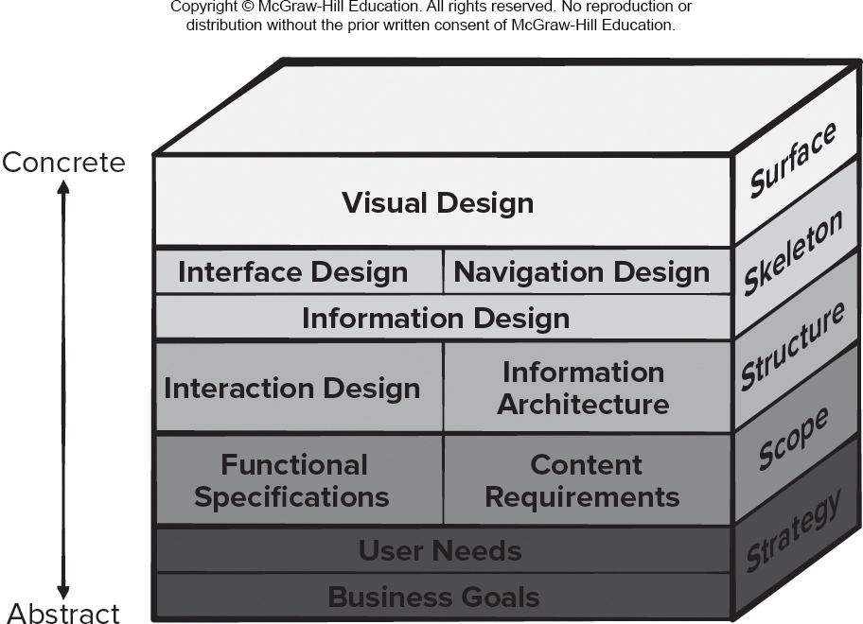
User Experience Design Elements 2
Access the text alternative for slide images.

Slide 87
Chapter 15
Quality Concepts
Part Three – Quality and Security

Slide 88
What is Quality?
The American Heritage Dictionary defines quality as “a characteristic or attribute of something.”
For software, three kinds of quality may be encountered:
Quality of design encompasses requirements, specifications, and the design of the system.
Quality of conformance is an issue focused primarily on implementation.
User satisfaction = compliant product + good quality + delivery within budget and schedule.

Slide 89
Software Quality
Software quality can be defined as:
An effective software process applied in a manner that creates a useful product that provides measurable value for those who produce it and those who use it.
Advantages of providing useful products:
Greater software product revenue.
Better profitability when an application supports a business process.
Improved availability of information that is crucial for the business.

Slide 90
Software Quality – Effective Process
An effective software process establishes infrastructure that supports building a high-quality software product.
The management aspects of process create the checks and balances that help avoid project chaos—a key contributor to poor quality.
Software engineering practices allow the developer to analyze the problem and design a solid solution—both critical to building high quality software.
Umbrella activities such as change management and technical reviews have as much to do with quality as any other part of software engineering practice.

Slide 91
Software Quality – Useful Product
A useful product delivers the content, functions, and features that the end-user desires.
But as important, it delivers these assets in a reliable, error free way.
A useful product always satisfies those requirements that have been explicitly stated by stakeholders.
A useful product satisfies a set of implicit requirement that are expected of all high-quality software.

Slide 92
Software Quality – Adding Value
By adding value for both the producer and user of a software product, high quality software provides benefits for the software organization and the end-user community.
The software organization gains added value because high quality software requires less maintenance effort, fewer bug fixes, and reduced customer support.
The user community gains added value because the application provides a useful capability in a way that expedites some business process.

Slide 93
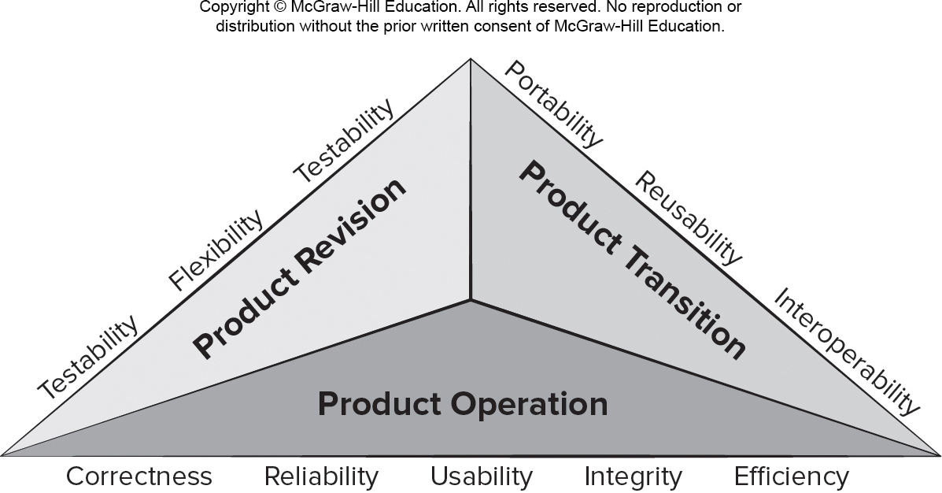
McCall’s Quality Factors
Access the text alternative for slide images

Slide 94
Software Quality Dilemma进退两难 Good Enough Software Cost of Quality
If you produce a software system that has terrible quality, you lose because no one will want to buy it.
If you spend infinite time, extremely large effort, and huge sums of money to build a perfect piece of software, then it's going to take so long to complete and will be so expensive to produce that you'll be out of business.
You will either missed the market window, or you exhausted all your resources.
People in industry try to find that magical middle ground where the product is good enough not to be rejected right away, but also not the object of so much perfectionism that it would take too long or cost too much to complete.

Slide 95
Cost of Quality
Prevention costs - quality planning, formal technical reviews, test equipment, training.
Appraisal costs - conducting technical reviews, data collection and metrics evaluation, testing and debugging.
Internal failure costs – rework, repair, failure mode analysis.
External failure costs - complaint resolution, product return and replacement, help line support, warranty work

Slide 96
Achieving实现 Software Quality 1
Software quality is the result of good project management and solid engineering practice.
To build high quality software you must understand the problem to be solved and be capable of creating a quality design the conforms to the problem requirements.
Project management – project plan includes explicit techniques for quality and change management.
Use estimation to verify that delivery dates are achievable.
Schedule is understood and team avoids taking shortcuts.
Risk planning is conducted so problems do not breed chaos, software quality will be affected in a positive way.

Slide 97
Achieving Software Quality 2
Project plan should include explicit techniques for quality and change management.
Quality control - series of inspections, reviews, and tests used to ensure conformance of a work product to its specifications.
Quality assurance - consists of the auditing and reporting procedures used to provide management with data needed to make proactive decisions.
Defect prediction is an important part of identifying software components that may have quality concerns.
Machine learning and statistical models may help identify relationships between metrics and defection components.

Slide 98
Chapter 16
Reviews – A Recommended Approach
Part Three – Quality and Security

Slide 99
Reviews
What are they?
A meeting conducted by technical people.
A technical assessment of a work product created during the software engineering process.
A software quality assurance mechanism.
A training ground.
What they are not!
A project summary or progress assessment.
A meeting intended solely to impart information.
A mechanism for political or personal reprisal!

Slide 100
Cost Impact of Software Defects
Error—a quality problem found before the software is released to end users.交付前
Defect—a quality problem found only after the software has been released to end-users.交付后 缺陷 影响大
We make this distinction because errors and defects have very different economic, business, psychological, and human impact.

Slide 101
Review Metrics 1
Preparation effort, E_{p} — the effort (in person-hours) required to review a work product prior to the actual review meeting.
Assessment effort, E_{a} — the effort (in person-hours) that is expending during the actual review.
Rework effort, E_{r} — the effort (in person-hours) that is dedicated to the correction of those errors uncovered during the review.
Work product size, W P S — a measure of the size of the work product that has been reviewed (for example: the number of U M L models, or the number of document pages, or the number of lines of code).
Minor errors found, Err_{minor} — the number of errors found that can be categorized as minor (requiring less than some pre-specified effort to correct).
Major errors found, Err_{major} — the number of errors found that can be categorized as major (requiring more than some pre-specified effort to correct).

Slide 102
Review Metrics 2
Total errors found, Errtot. Represents the sum of the errors found:
Err_{tot} = Err_{minor} + Err_{major}
Error density. Represents the errors found per unit of work product reviewed:
Error density = Err_{tot} ÷ W P S

Slide 103
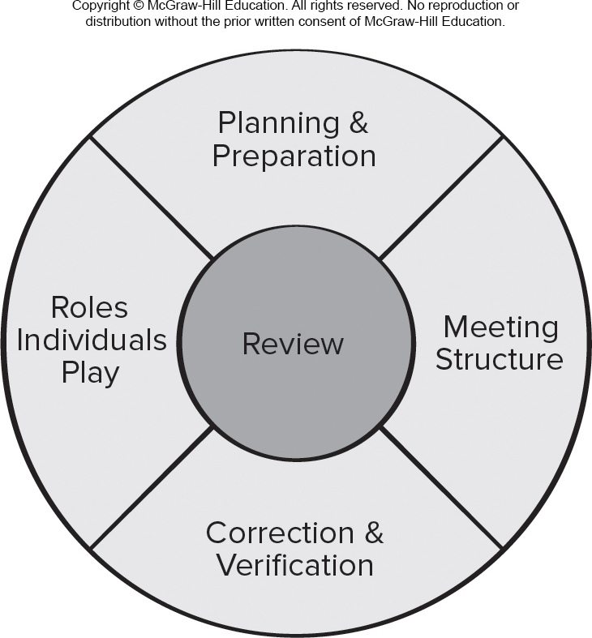
Reference Model for Technical Reviews
Access the text alternative for slide images.

Slide 104
Formal Technical Reviews
The objectives of an F T R (walkthrough or inspection) are:
To uncover errors in function, logic, or implementation for any representation of the software.
To verify that the software under review meets its requirements.
To ensure that the software has been represented according to predefined standards.
To achieve software that is developed in a uniform manner.
To make projects more manageable.

Slide 105
Review Players
Producer—the individual who has developed the work product.
Review leader—evaluates the product for readiness, generates copies of product materials, and distributes them to two or three reviewers for advance preparation and facilitates the meeting discussion.
Reviewer(s)—expected to spend between one and two hours reviewing the product, making notes, and otherwise becoming familiar with the work.
Recorder—reviewer who records (in writing) all important issues raised during the review.

Slide 106
Review Reporting and Record Keeping
During the F T R, the recorder records all issues raised and summarizes these in a review issues list to serve as an action list for the producer.
A formal technical review summary report is created that answers three questions:
What was reviewed?
Who reviewed it?
What were the findings and conclusions?
You should establish a follow-up procedure to ensure that items on the issues list have been properly corrected.

Slide 107
Chapter 17
Software Quality Assurance
Part Three – Quality and Seccurity

Slide 108
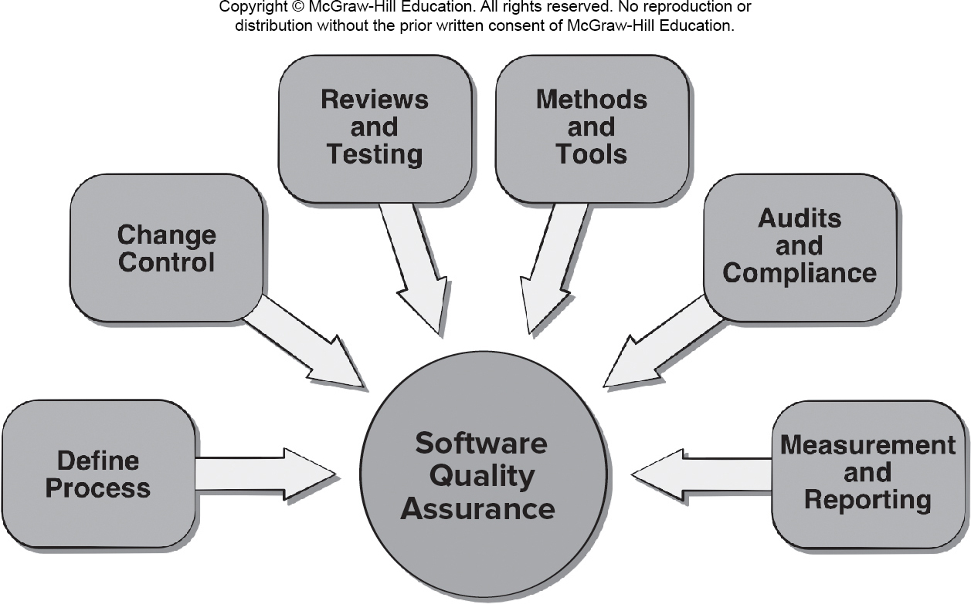
Software Quality Assurance SQA
Access the text alternative for slide images.

Slide 109
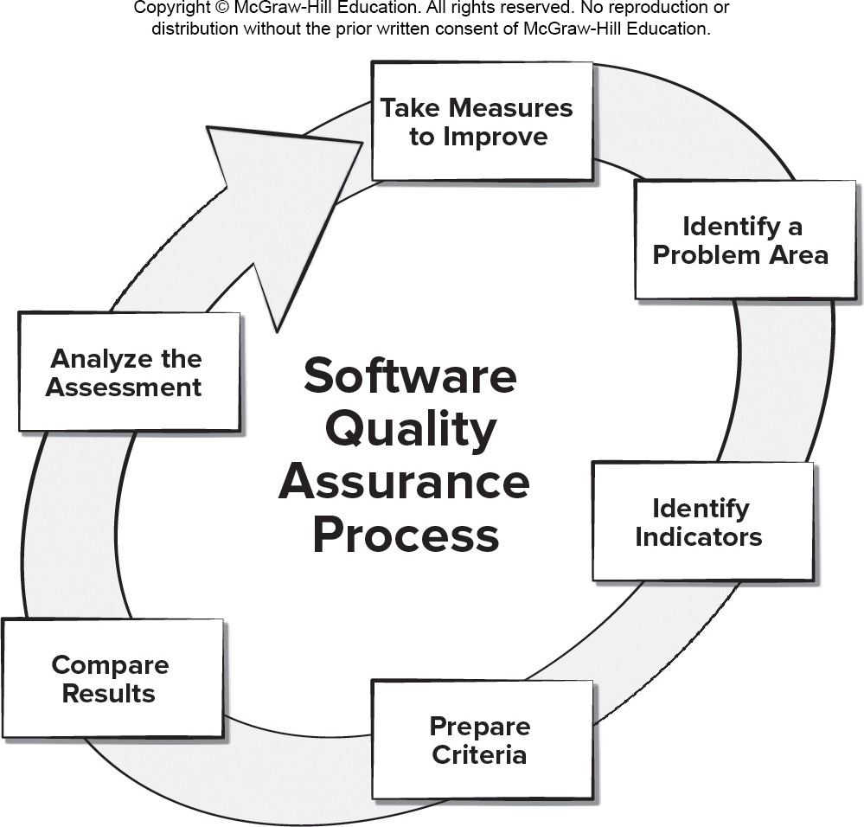
Data Driven S Q A
Access the text alternative for slide images.

Slide 110
S Q A Goals
Requirements quality. The correctness, completeness, and consistency of the requirements model will have a strong influence on the quality of all work products.
Design quality. Every element of the design model should be assessed to ensure that it exhibits high quality and that the design itself conforms to requirements.
Code quality. Source code and related work products must conform to local coding standards and exhibit characteristics that will facilitate maintainability.
Quality control effectiveness. A software team should apply limited resources in a way that has the highest likelihood of achieving a high quality result.

Slide 111
Chapter 19
Software Testing – Component Level
Part Three – Quality and Security

Slide 112
Verification and Validation
Verification refers to the set of tasks that ensure that software correctly implements a specific function.
Verification: Are we building the product right?
Validation refers to a different set of tasks that ensure that the software that has been built is traceable to customer requirements.
Validation: "Are we building the right product?"
Black/White Box Test

Slide 113
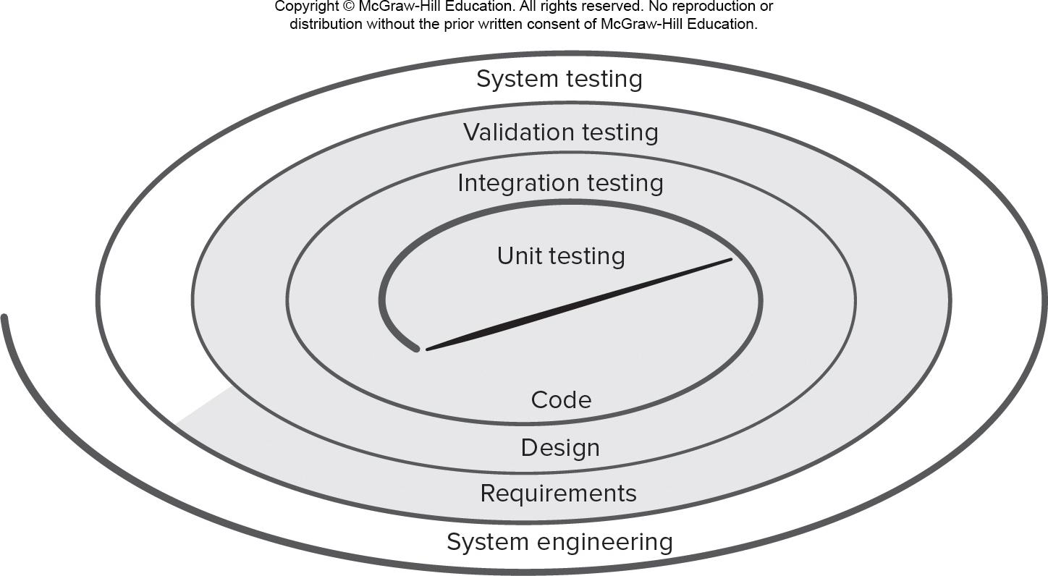
Testing Strategy
Access the text alternative for slide images.

Slide 114
Chapter 20
Software Testing – Integration Level
Part Three – Quality and Security

Slide 115
Top-Down Integration 1
Top-down integration testing is an incremental approach to construction of the software architecture.
Modules are integrated by moving downward through the control hierarchy, beginning with the main control module (main program).
Modules subordinate to the main control module are incorporated into the structure followed by their subordinates.
Depth-first integration integrates all components on a major control path of the program structure before starting another major control path.
Breadth-first integration incorporates all components directly subordinate at each level, moving across the structure horizontally before moving down to the next level of subordinates.

Slide 116
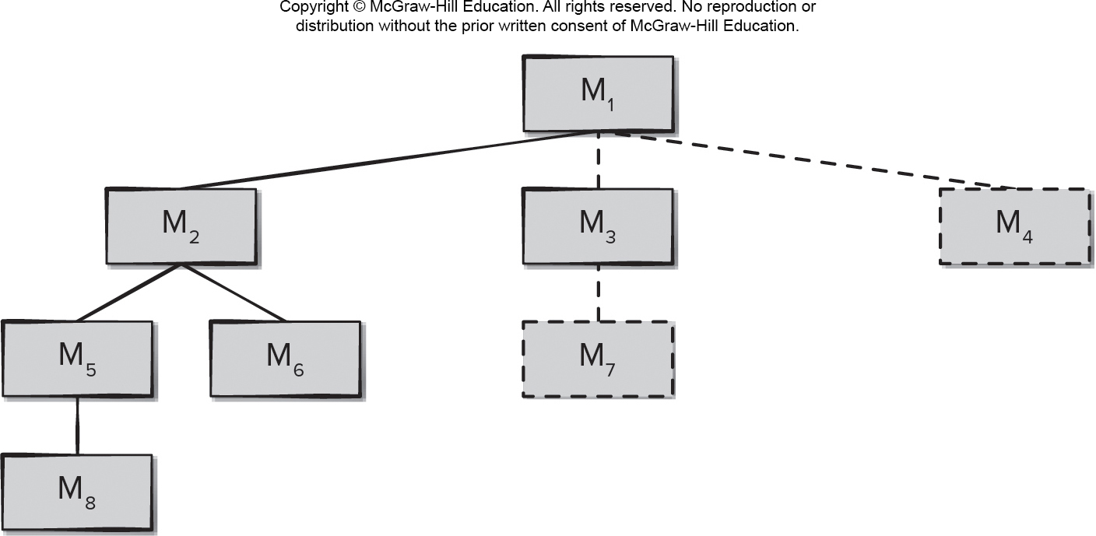
Top-Down Integration 自上而下集成
Access the text alternative for slide images.

Slide 117
Bottom-Up Integration Testing 自下而上
Bottom-up integration testing, begins construction and testing with atomic modules components at the lowest levels in the program structure.
Low-level components are combined into clusters (builds) that perform a specific software subfunction.
A driver (a control program for testing) is written to coordinate test-case input and output.
The cluster is tested.
Drivers are removed and clusters are combined, moving upward in the program structure.

Slide 118
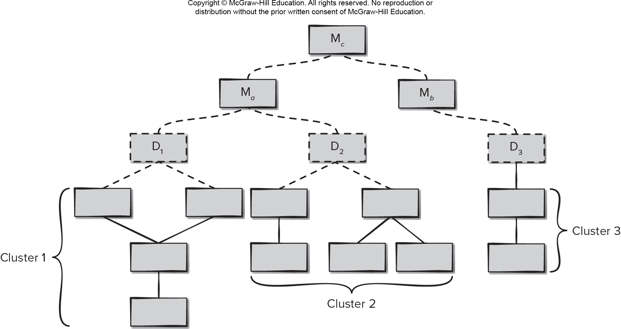
Bottom-Up Integration
Access the text alternative for slide images.

Slide 119
Continuous Integration
Continuous integration is the practice of merging components into the evolving software increment at least once a day.
This is a common practice for teams following agile development practices such as X P or DevOps. Integration testing must take place quickly and efficiently if a team is attempting to always have a working program in place as part of continuous delivery.
Smoke testing is an integration testing approach that can be used when software is developed by an agile team using short increment build times.

Slide 120
Regression Testing
Regression testing is the re-execution of some subset of tests that have already been conducted to ensure that changes have not propagated unintended side effects.
Whenever software is corrected, some aspect of the software configuration (the program, its documentation, or the data that support it) is changed.
Regression testing helps to ensure that changes (due to testing or for other reasons) do not introduce unintended behavior or additional errors.
Regression testing may be conducted manually, by re-executing a subset of all test cases or using automated capture/playback tools.
AI tools may be able to help select the best subset of test cases to use in regression automatically based on previous experiences of the developers with the evolving software product.

